Slide 1
Shared Robo-Vision
Alberto Vaccari | Yu Liu | Dapeng Lan

Slide 2
Introduction
Notes:
<number>

Slide 3
Introduction
Notes:
<number>

Slide 4
Introduction
RoboCup is an annual international robotics competition with the aim to promote robotics and AI research. This project is trying to create a tool for logging matches and the behavior of robots in the match.
The main idea is to position 2 cameras on each side of the match field. Cameras are connected to Zedboard, after pre-processing with FPGA, images captured by camera will be sent to PC for further handling to detect the positions of robots and ball, record the match and control specific robot.
Notes:
<number>

Slide 5
System Diagram
Notes:
<number>

Slide 6
System Diagram
Notes:
<number>

Slide 7
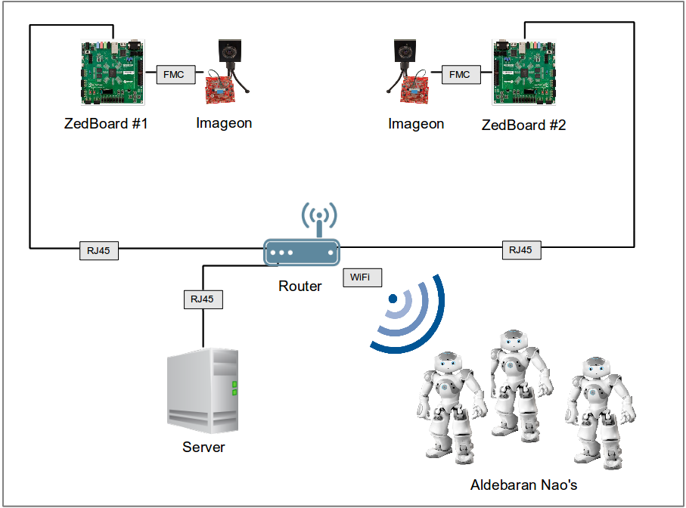
System Diagram
Notes:
<number>

Slide 8
Objectives
Notes:
<number>

Slide 9
Objectives
Notes:
<number>

Slide 10
Objectives
Transmit HD images (1920*1080) from 2 ZedBoards to a computer
Perform some degree of image processing directly on the ZedBoards
Track the position of the robots on the field
Track the position of the ball on the field
Record a match
Replay a recorded match
Control the movements of the robots from the server application
Notes:
<number>

Slide 11
Roles
Notes:
<number>

Slide 12
Roles
Notes:
<number>

Slide 13
Roles
Alberto:
☐ Tracking of the robots
☐ Tracking of the ball
☐ Recording a match
☐ Replaying a saved match
☐ Communication and control of the robots
Yu:
☐ Receiving images from the ZedBoard
☐ Image pre-processing on the ZedBoards
Dapeng:
☐ Fetching HD images from FMC-Imageon V2000C camera
☐ Transmission of HD images from 2 ZedBoards to the server
☐ Image pre-processing on the ZedBoards
Notes:
<number>

Slide 14
Roles
Alberto:
☑ Tracking of the robots
☑ Tracking of the ball
☑ Recording a match
☑ Replaying a saved match
☑ Communication and control of the robots
Yu:
☑ Receiving images from the ZedBoard
☐ Image pre-processing on the ZedBoards
Dapeng:
☑ Fetching HD images from FMC-Imageon V2000C camera
☒ Transmission of HD images from 2 ZedBoards to the server
☐ Image pre-processing on the ZedBoards
Notes:
<number>

Slide 15
Hardware
Notes:
<number>

Slide 16
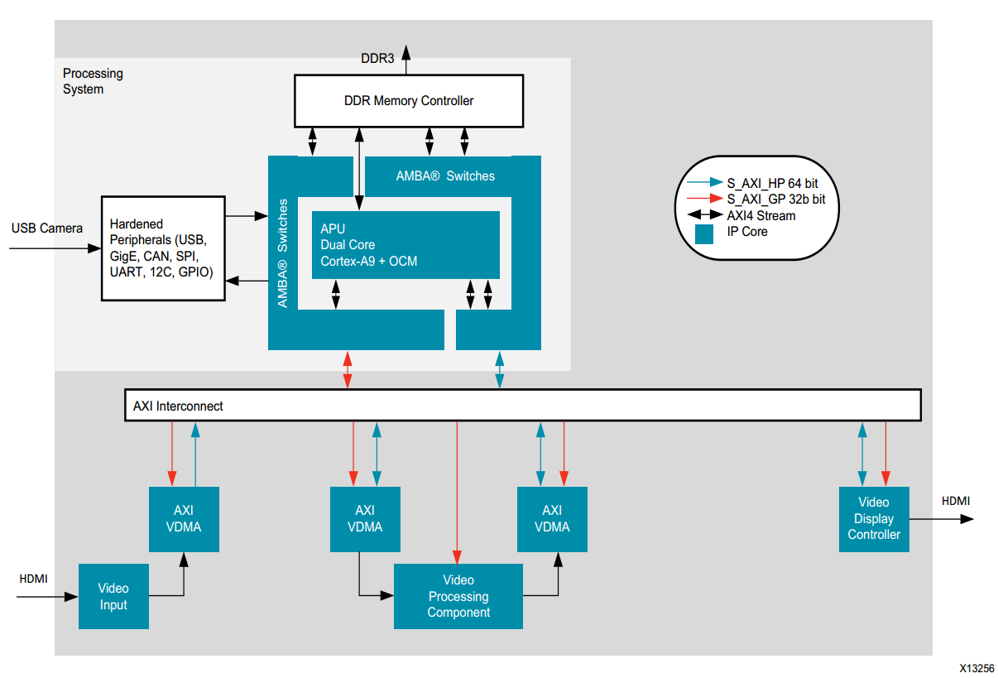
Hardware - structure
Notes:
<number>

Slide 17
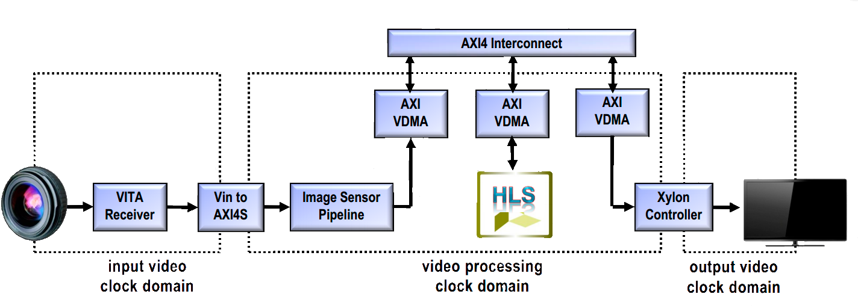
Hardware - structure
●AXI4-Lite for processor control of various IP cores (not shown): 50 MHz
●AXI4-Stream for point-to-point video connections :148.5MHz
●AXI4 for high-performance access to external memory
Notes:
<number>

Slide 18
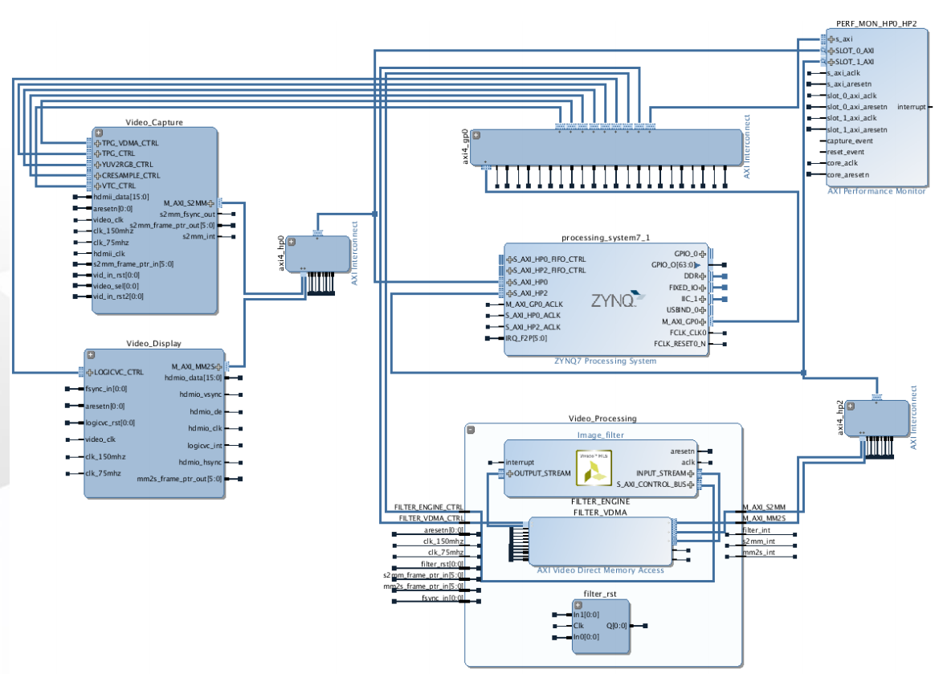
Notes:
<number>

Slide 19
Hardware – Image Capture
Notes:
<number>

Slide 20
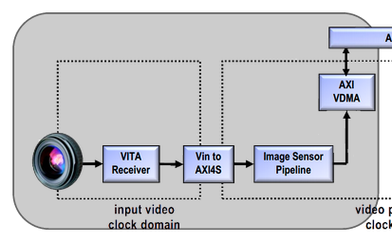
Hardware – Image Capture
The function of this part is:
Add FMC-IMAGEON cores to IP Catalog
Create Video Pipeline
• VITA Receiver core + Video to AXI4-Stream bridge
• Image Processing cores : DPC, CFA
• AXI Video DMA
DPC: Defect Pixel Correction
CFA: Colour Filter Interpolation
VDMA: video direct memory access
• Three frame buffers in circular mode
• Tdata widths of 24 bits
Notes:
<number>

Slide 21
Hardware – Image process
1
Notes:
<number>

Slide 22
Hardware – Image process
1
2
Notes:
<number>

Slide 23
Hardware – Image process
1
2
3
Notes:
<number>

Slide 24
Hardware – Image process
4
1
2
3
Notes:
<number>

Slide 25
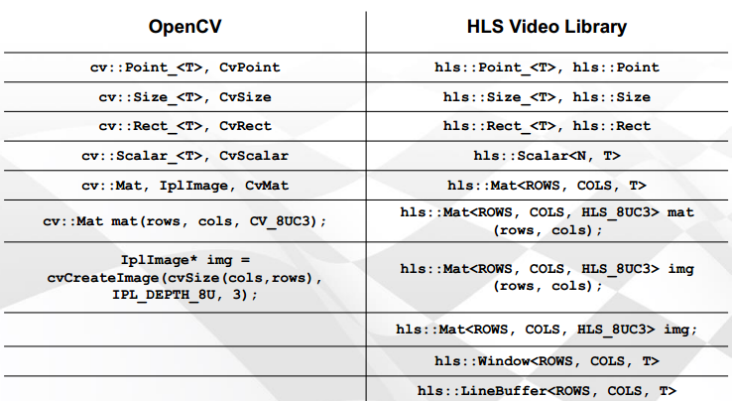
Hardware
Video Processing in Vivado HLS
These libraries are implemented as synthesizable C++ code and roughly correspond to video processing functions and data structures implemented in OpenCV.
Notes:
<number>

Slide 26
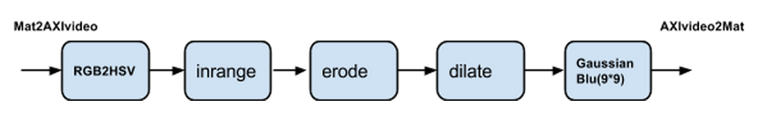
Hardware
Pre-image processing
Notes:
<number>

Slide 27
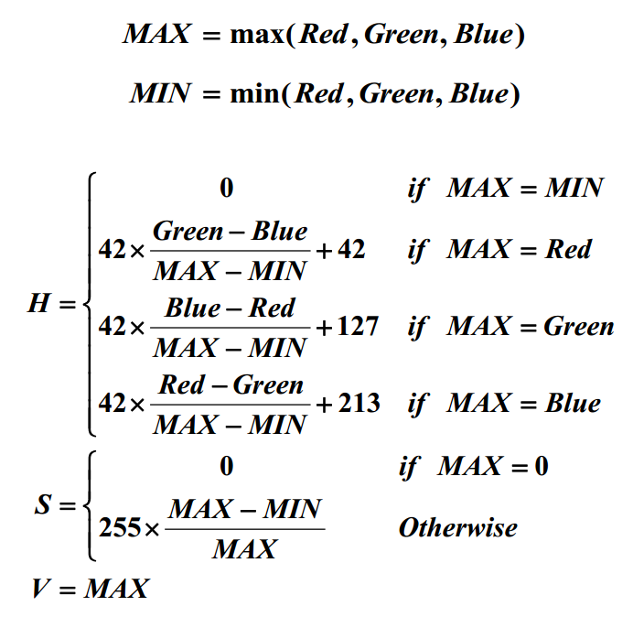
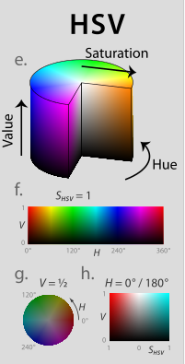
Hardware
BGR2HSV algorithm
https://en.wikipedia.org/wiki/HSL_and_HSV
Notes:
<number>

Slide 28
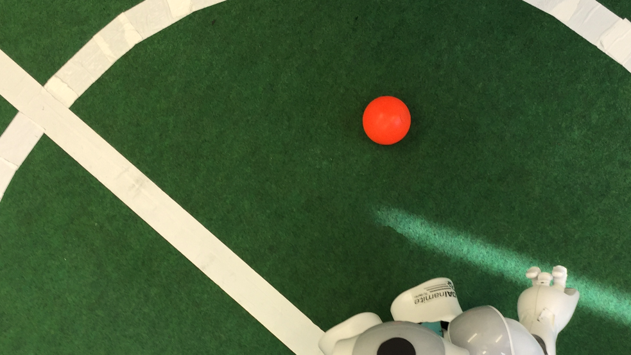
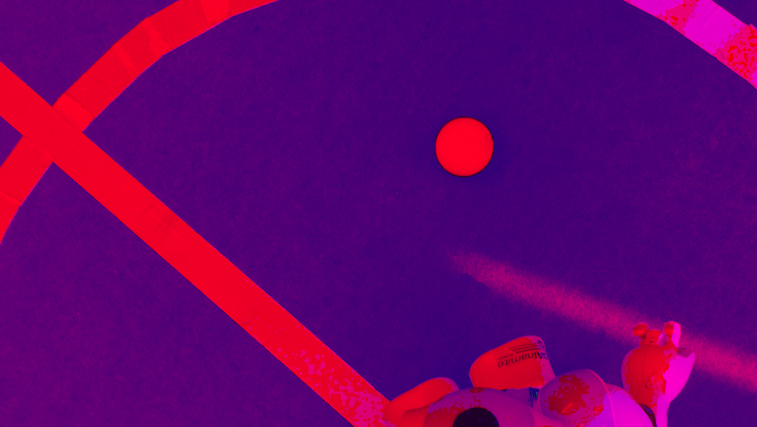
Hardware - Results
Video1: rgb2hsv https://youtu.be/gzL8fef96NY
Notes:
<number>

Slide 29
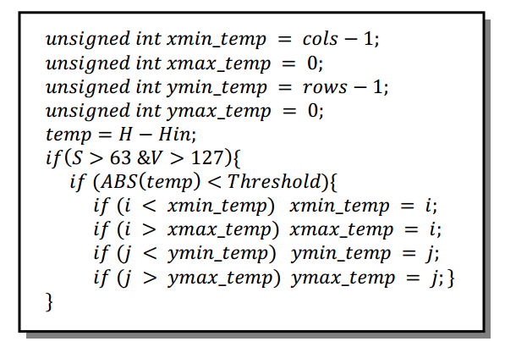
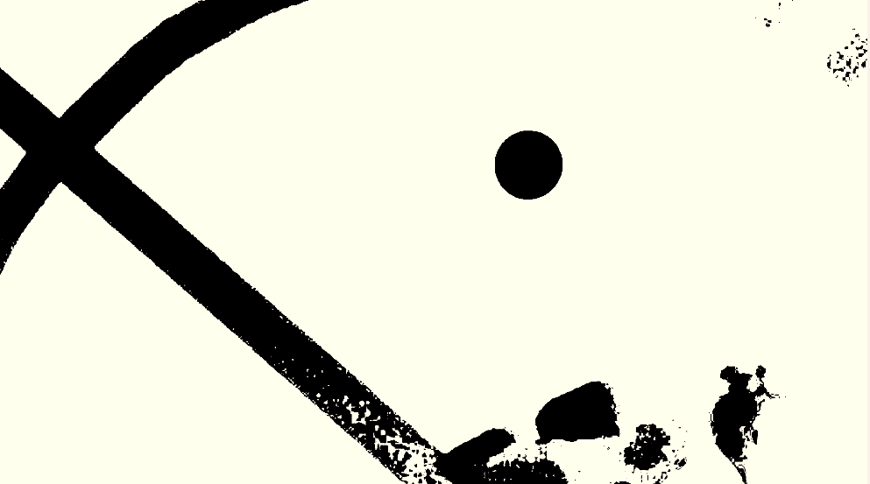
Hardware - Results
inRange
We compare the HSV values of the pixel with an input value (Hin) chosen by the user. If H is close enough to that input value and S and V are big enough, then the pixel will be tracked.
Here we choose the color red
Notes:
<number>

Slide 30
Hardware
Following using the IP core from Vivado HLS:
Erode
The basic idea of erosion is like soil erosion only.
simply white region decreases in the image.
It is useful for removing small white noises.
Dilate
It is just opposite of erosion.
it increases the white region in the.
Normally, in cases like noise removal, erosion is followed by dilation.
Because, erosion removes white noises, but it also shrinks our object. So we dilate it.
Gaussian blur to reduce image noise and reduce detail.
Notes:
<number>

Slide 31

Hardware - Results
Inrange
Notes:
<number>

Slide 32
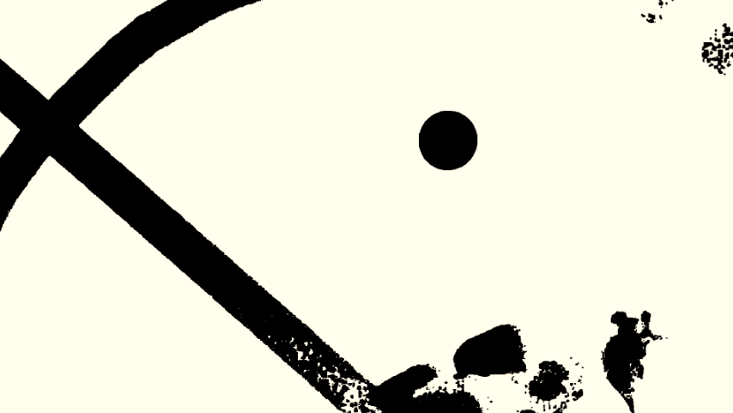
Hardware - Results
Erode
Notes:
<number>

Slide 33
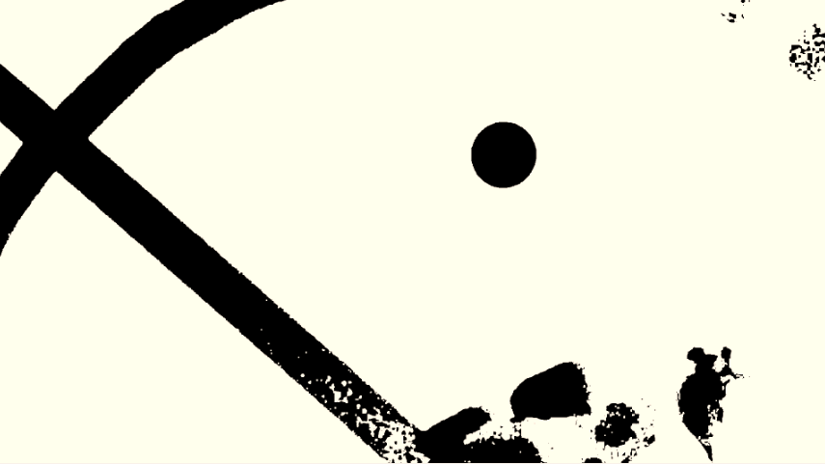
Hardware - Results
Dilate
Dilate
Notes:
<number>

Slide 34

Hardware - Results
Gaussianblur
Dilate
https://youtu.be/HWQ5UchrgNM
Notes:
<number>

Slide 35
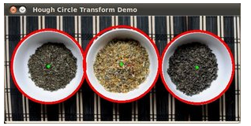
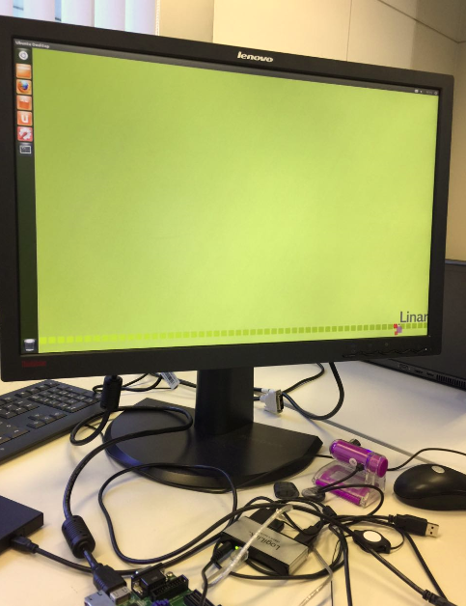
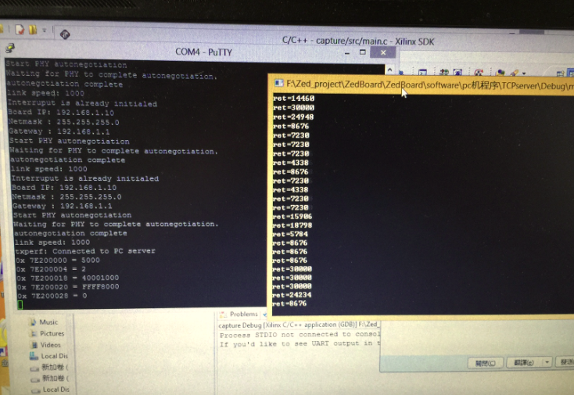
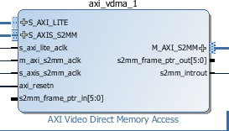
Hardware – Problems
Hough circle implementation in hardware
- if want to using shape recognizing, have to use Hough circle
- next step
UDP or TCP sending
Can send some strings
using Linux.
cannot use high resolution camera.
Notes:
<number>

Slide 36
Software
Notes:
<number>

Slide 37
Software – Robot Tracking
Notes:
<number>

Slide 38
Software – Robot Tracking
Initial intuition:
Use already existing patterns on Nao
Notes:
<number>

Slide 39
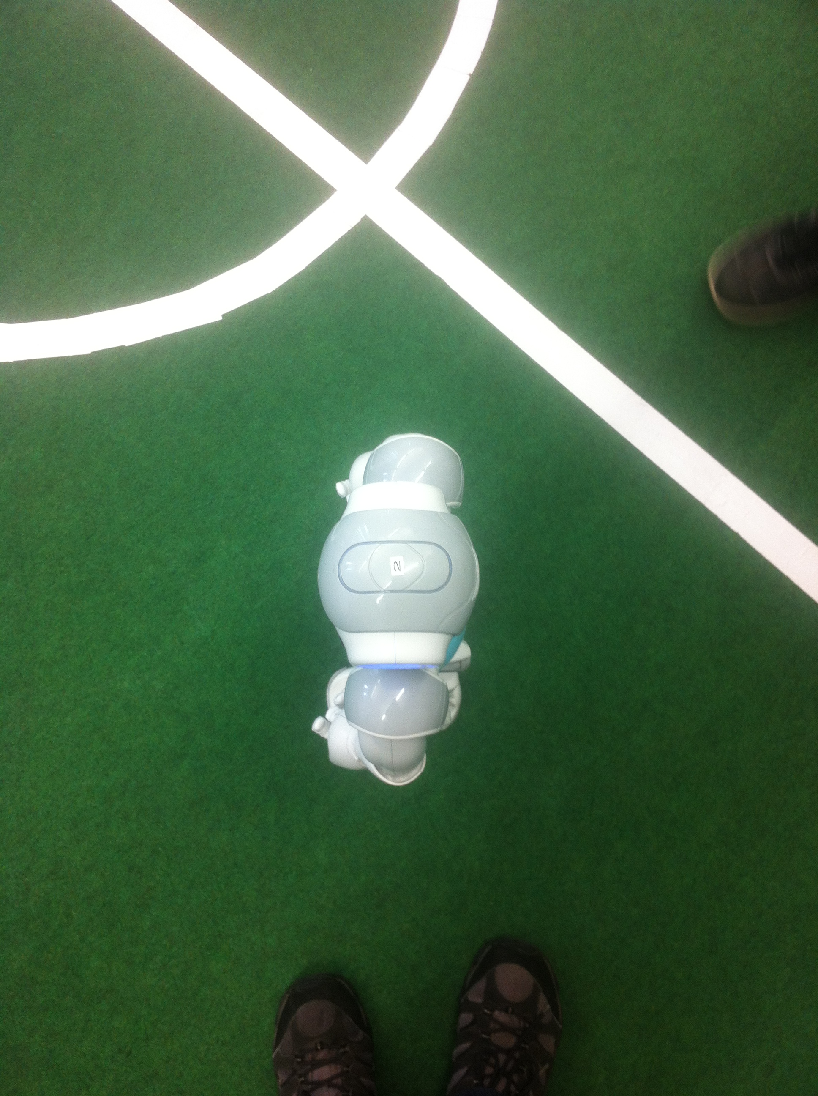
Software – Robot Tracking
Initial intuition:
Use already existing patterns on Nao
Notes:
<number>

Slide 40

Software – Robot Tracking
Initial intuition:
Use already existing patterns on Nao
Notes:
<number>

Slide 41
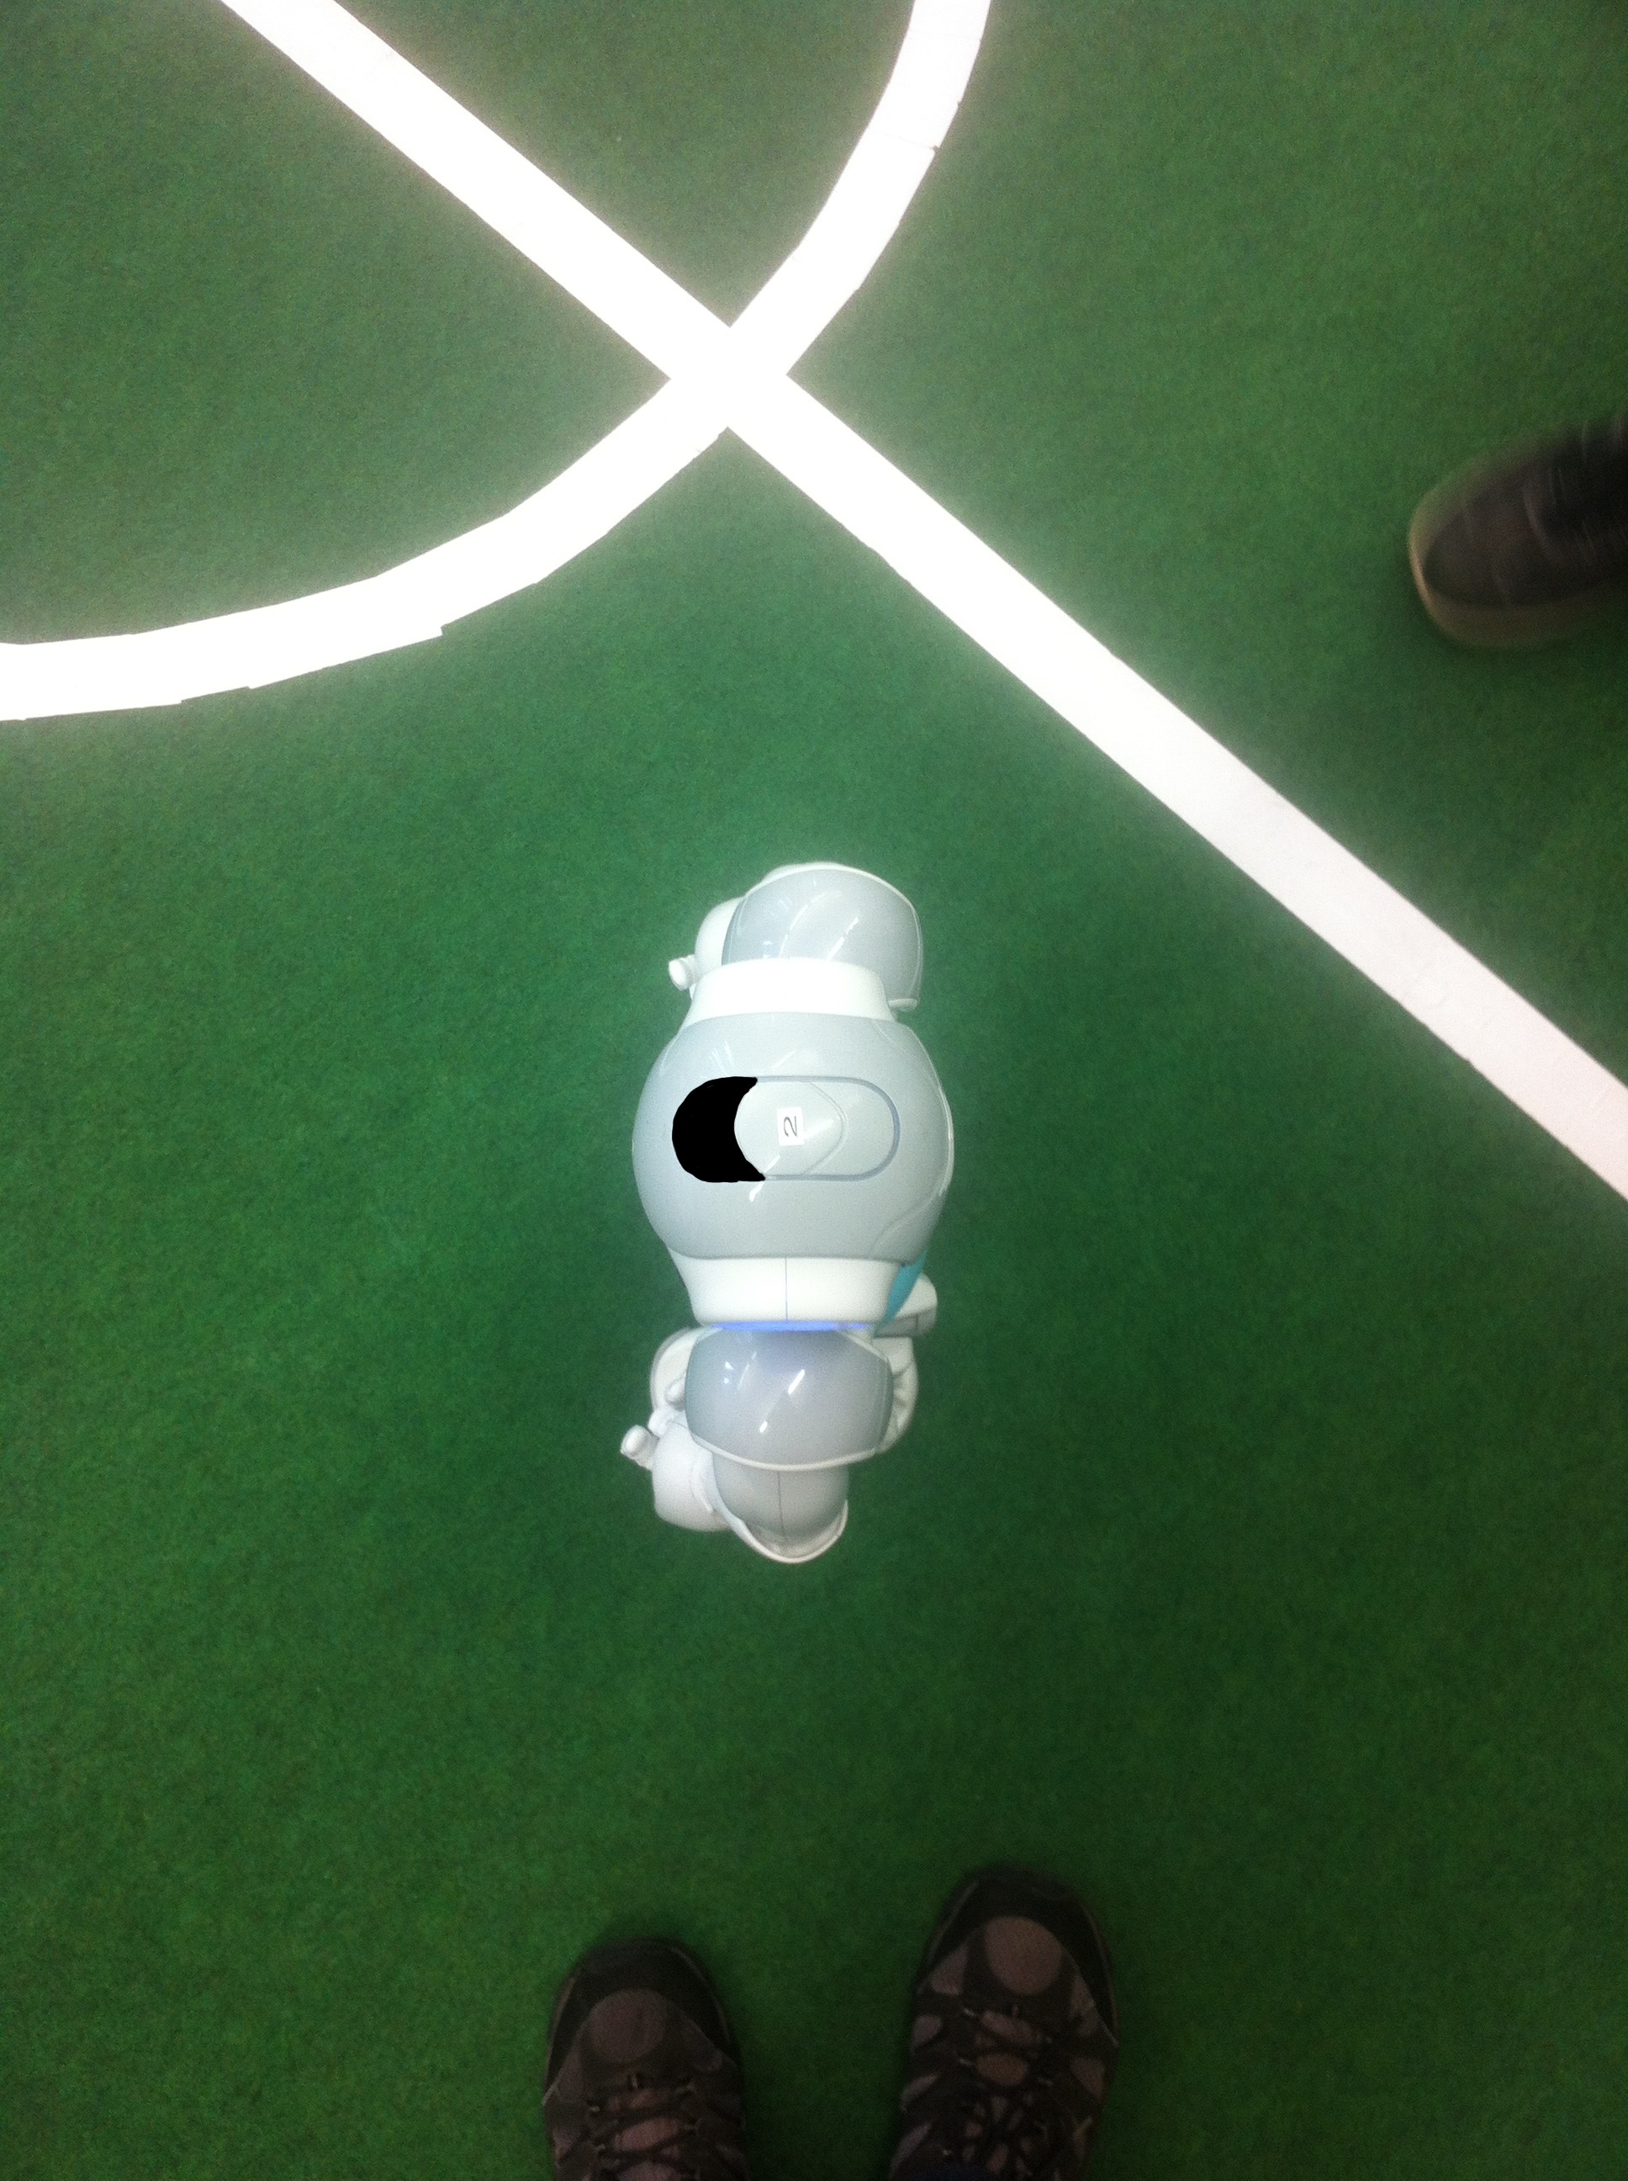
Software – Robot Tracking
Initial intuition:
Use already existing patterns on Nao
Notes:
<number>

Slide 42
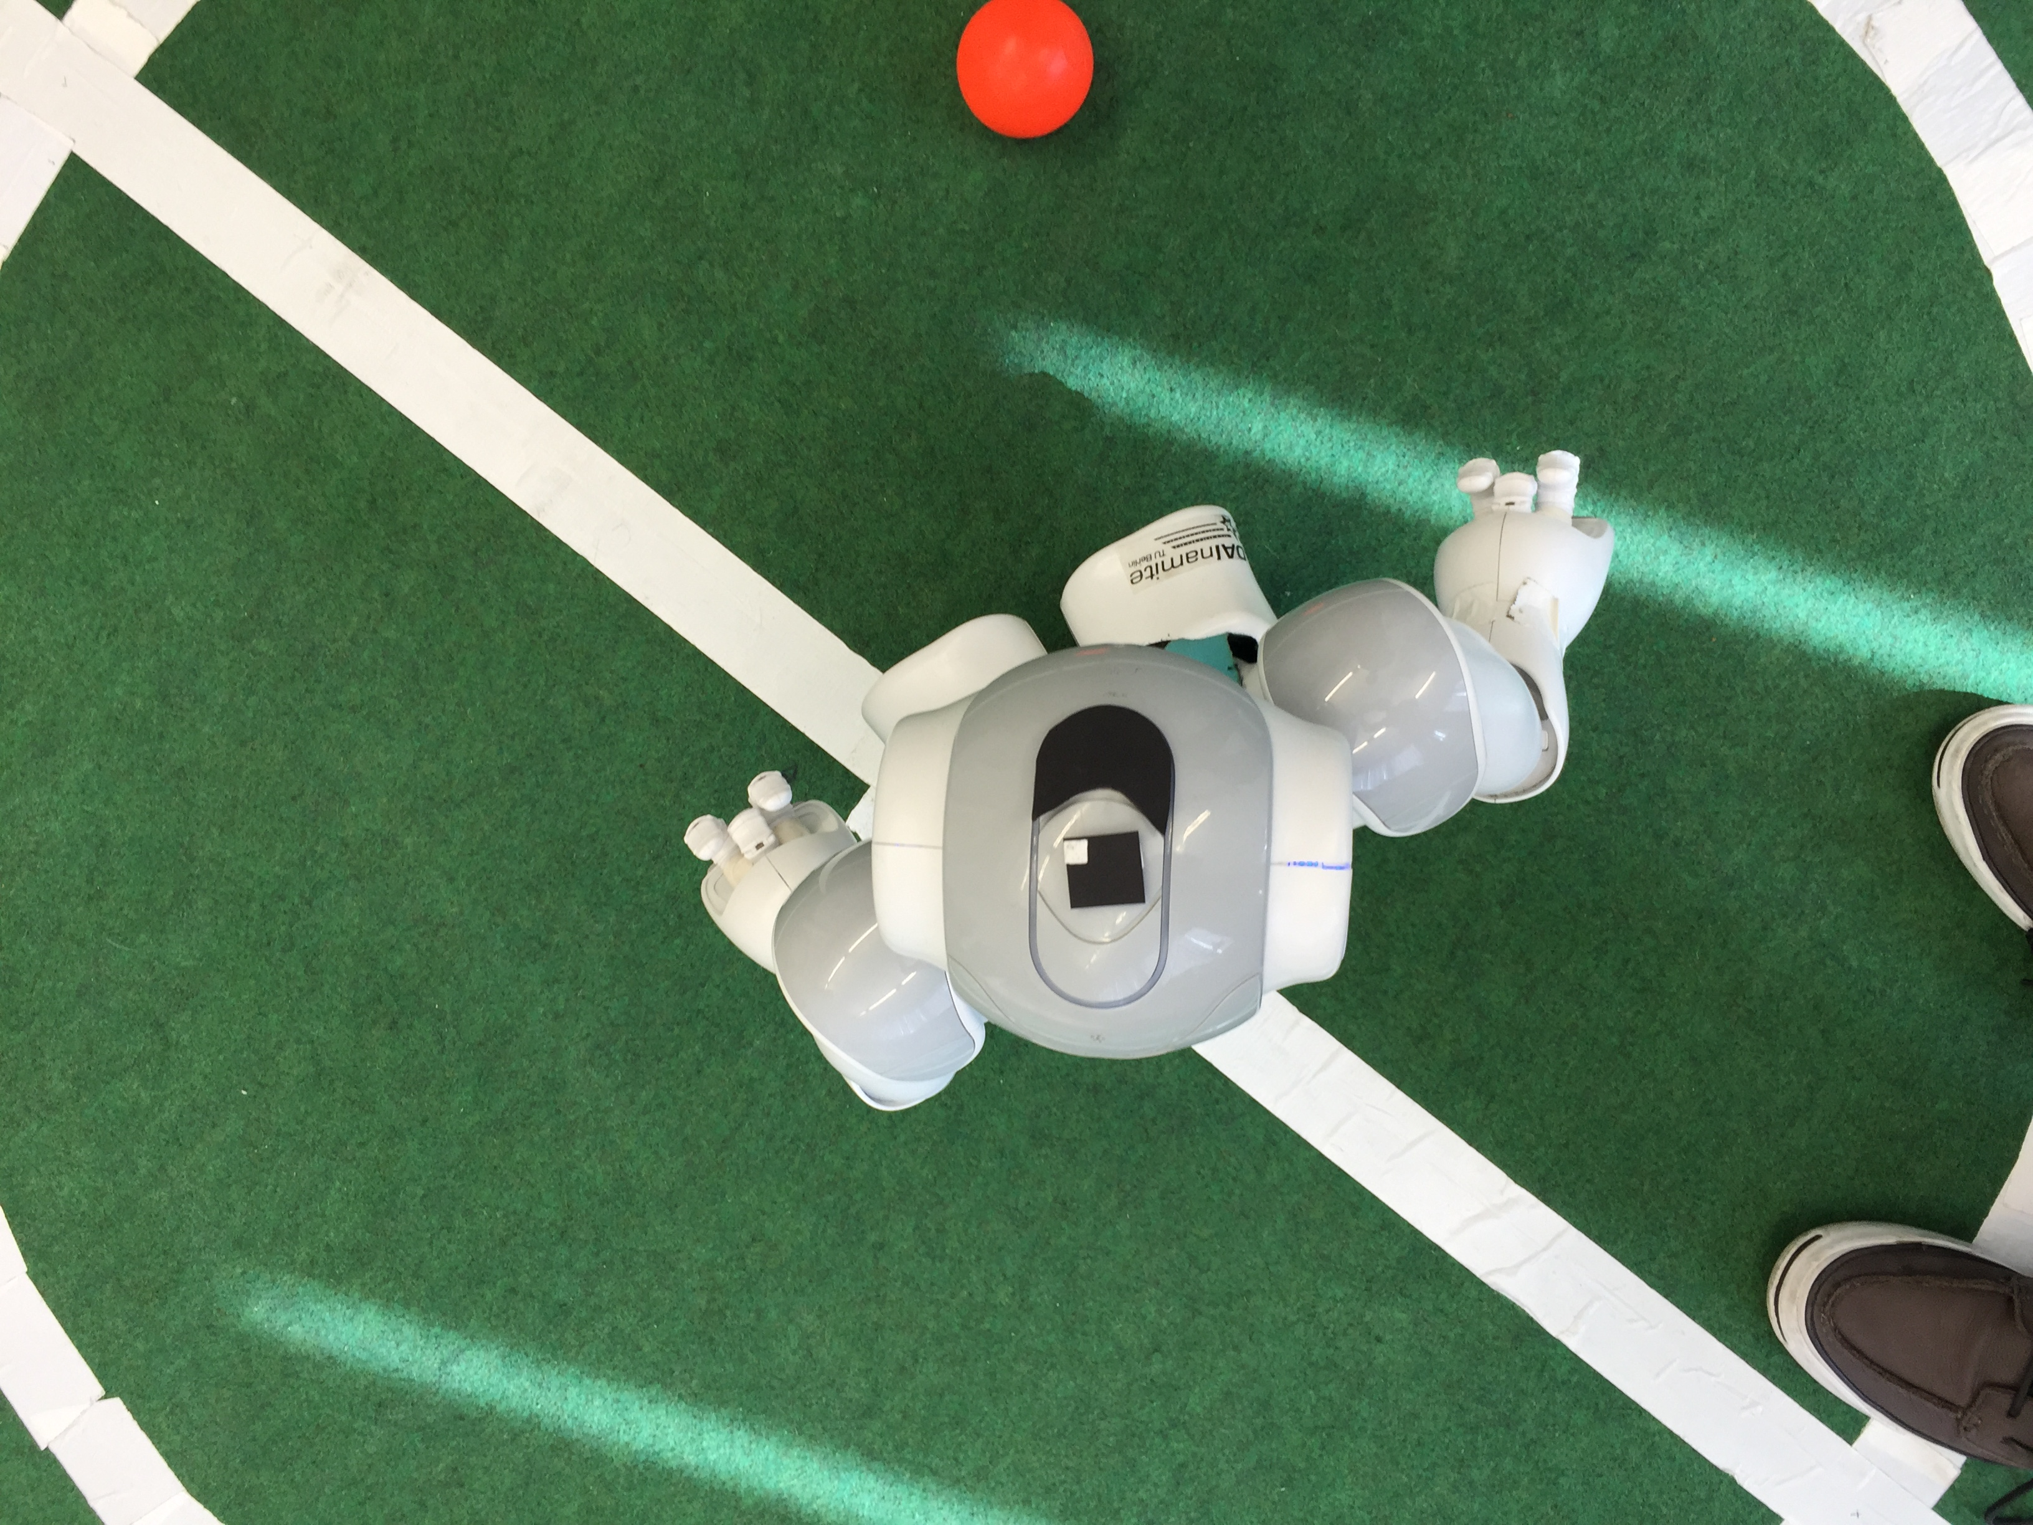
Software – Robot Tracking
Initial intuition:
Use already existing patterns on Nao
Add marker to uniquely identify each robot
Notes:
<number>

Slide 43
Software – Robot Tracking
Problems with initial intuition:
Custom shape matching not directly providing angles
Additional processing for the custom ID marker
Notes:
<number>

Slide 44
Software – Robot Tracking
Problems with initial intuition:
Custom shape matching not directly providing angles
Additional processing for the custom ID marker
Solution:
Notes:
<number>

Slide 45

Software – Robot Tracking
Problems with initial intuition:
Custom shape matching not directly providing angles
Additional processing for the custom ID marker
Solution: ArUco markers
Notes:
<number>

Slide 46
Software – Robot Tracking
Problems with initial intuition:
Custom shape matching not directly providing angles
Additional processing for the custom ID marker
Solution: ArUco markers
Provide 3D coordinates and marker rotation
Provide up to 1023 unique ID's
Easy implementation
Rapid markers detection
Notes:
<number>

Slide 47
Software – Ball Tracking
Notes:
<number>

Slide 48
Software – Ball Tracking
Initial intuition:
Filter non-red elements from the frame
Use HoughCircles to find circles with specific size
Notes:
<number>

Slide 49
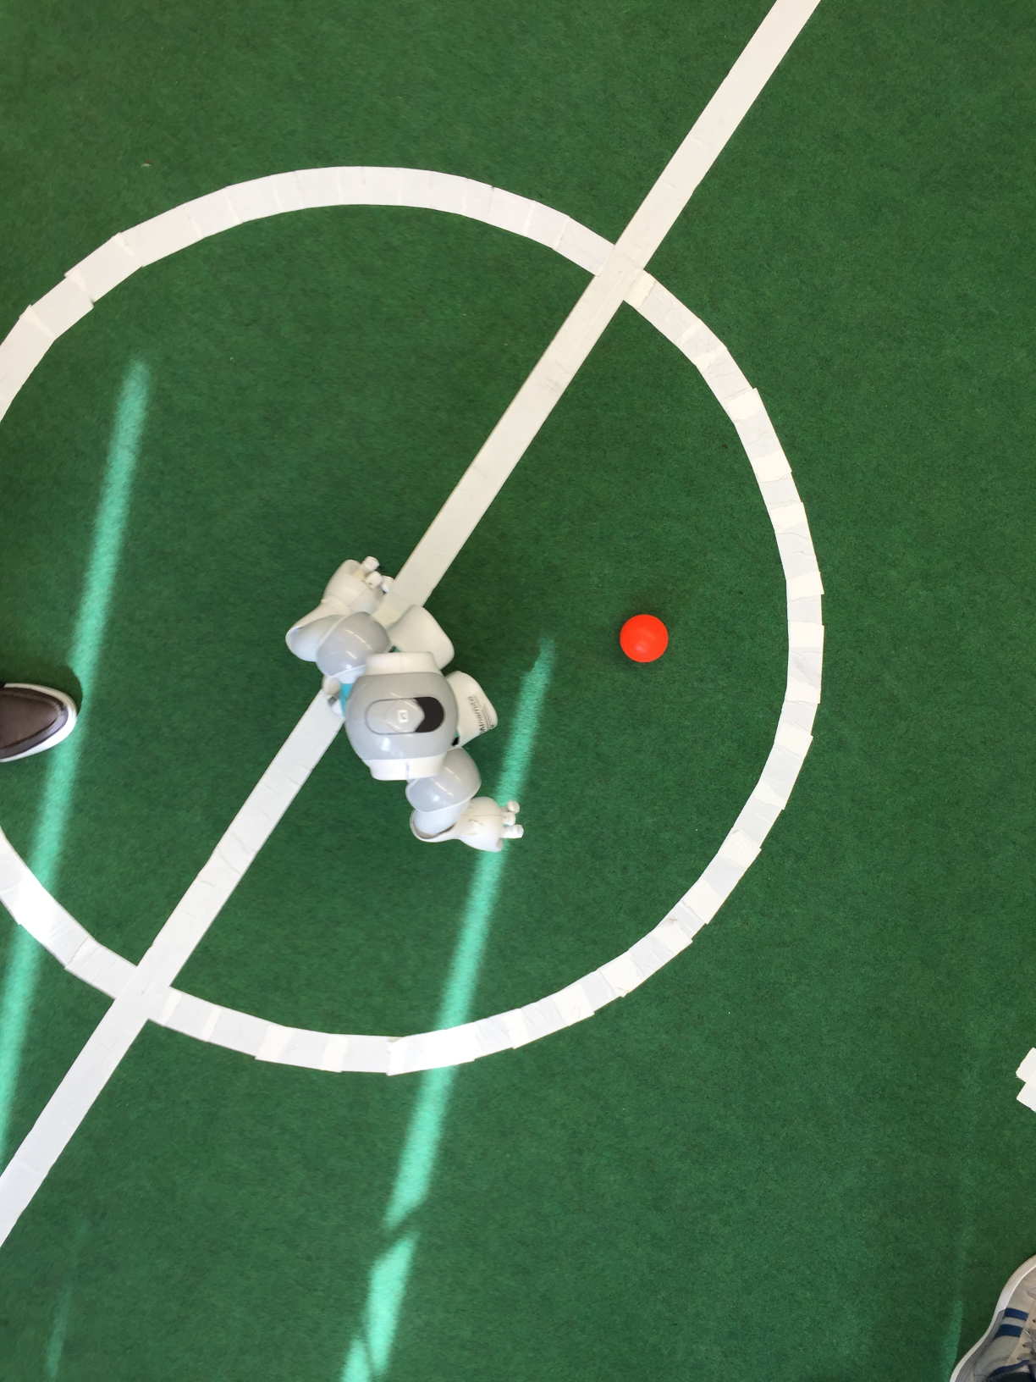
Software – Ball Tracking
Initial intuition:
Filter non-red elements from the frame
Use HoughCircles to find circles with specific size
Notes:
<number>

Slide 50

Software – Ball Tracking
Initial intuition:
Filter non-red elements from the frame
Use HoughCircles to find circles with specific size
Notes:
<number>

Slide 51
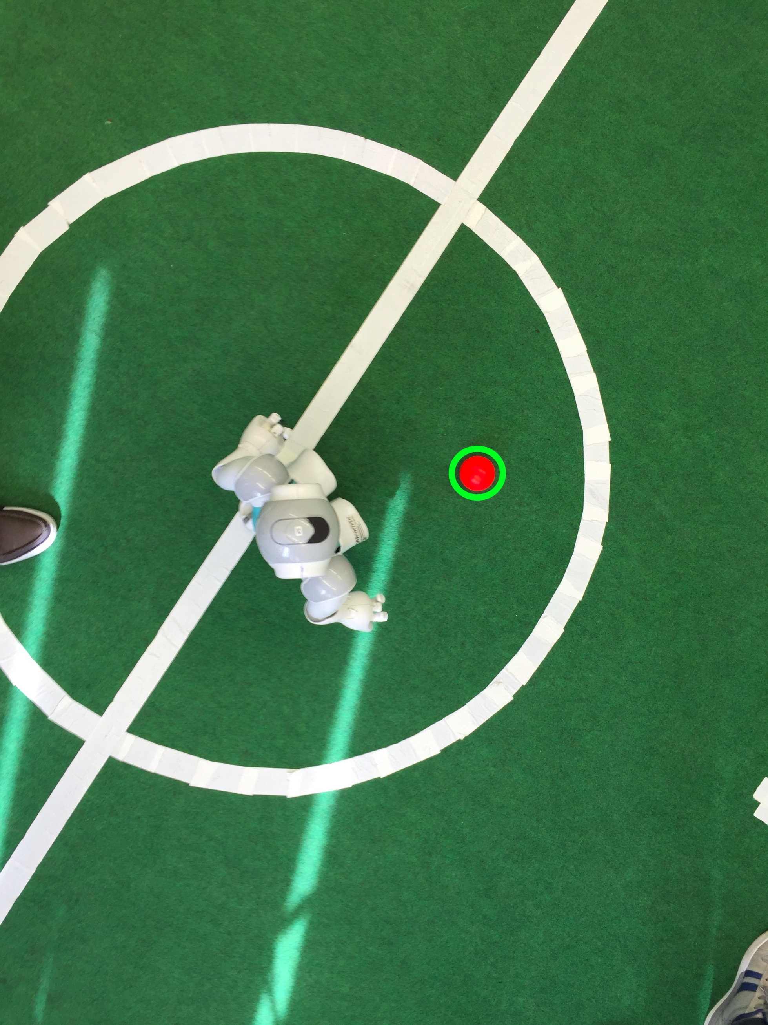
Software – Ball Tracking
Initial intuition:
Filter non-red elements from the frame
Use HoughCircles to find circles with specific size
Notes:
<number>

Slide 52
Software – Robot Control
Notes:
<number>

Slide 53
Software – Robot Control
Control robots from the application through the network (WiFi, using UDP):
Notes:
<number>

Slide 54
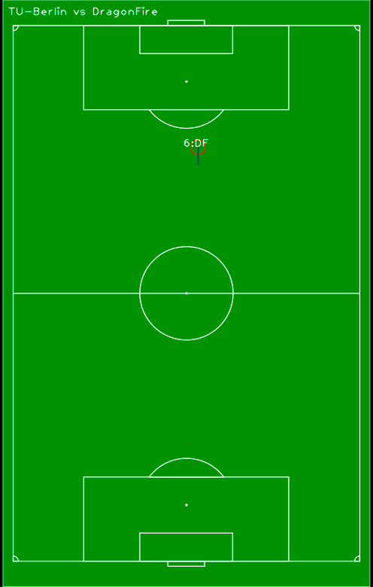
Software – Robot Control
Control robots from the application through the network (WiFi, using UDP):
Notes:
<number>

Slide 55
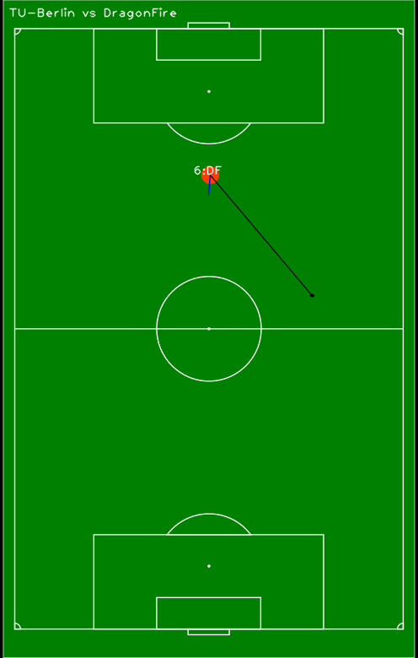
Software – Robot Control
Control robots from the application through the network (WiFi, using UDP):
Notes:
<number>

Slide 56
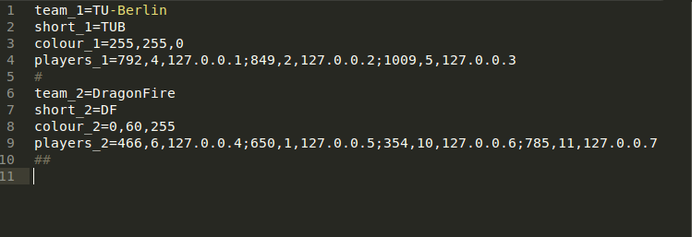
Software – Robot Control
Robot information (Team Name, Team Colour, Players and IPs) stored in configuration file:
Notes:
<number>

Slide 57
DEMO
Notes:
<number>

Slide 58
The End
Alberto Vaccari | Yu Liu | Dapeng Lan

Slide 59
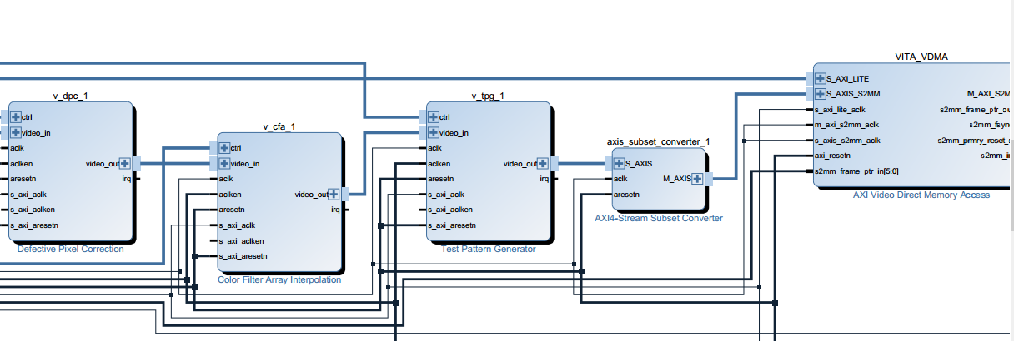
Backup slides
System-Level Analysis with AXI Perf. Monitoring
Access the memory speed:
HP0: Read 3.98 Gb/s, Write 3.98 Gb/s, Total 7.97 Gb/s;
HP2: Read 3.98 Gb/s, Write 3.98 Gb/s, Total 7.96 Gb/s
Notes:
<number>

Slide 60
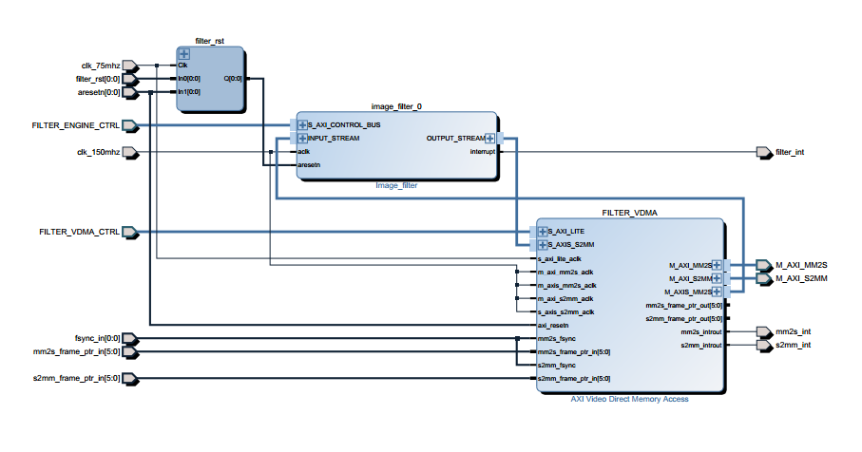
Backup slides
Notes:
<number>

Slide 61
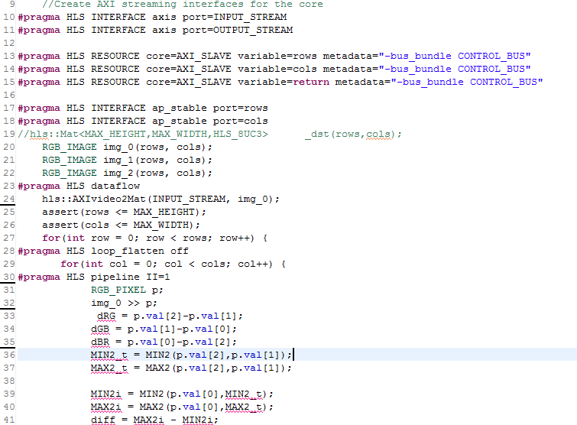
Backup slides
Notes:
<number>

Slide 62
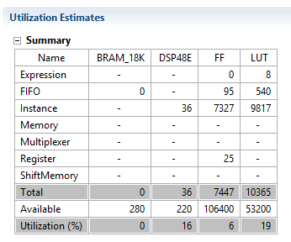
Backup slides
Notes:
<number>

Slide 63
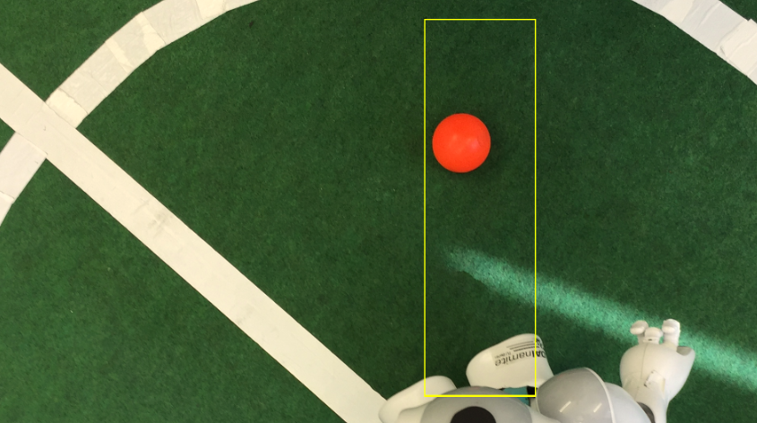
Only by color

